Slide 1
ETL Process and OLAP:
Module II(8 hrs)
Major steps in ETL process
Data extraction: techniques
Data transformation: Basic tasks, Major transformation types,
Data Loading: Applying Data,
OLTP Vs OLAP, OLAP definition,
Dimensional Analysis, Hypercubes,
OLAP operations: Drilldown, Roll up, Slice, Dice and Rotation, OLAP models : MOLAP, ROLAP.
CO2: Design data warehouse with dimensional modelling and apply OLAP operations.

Slide 2
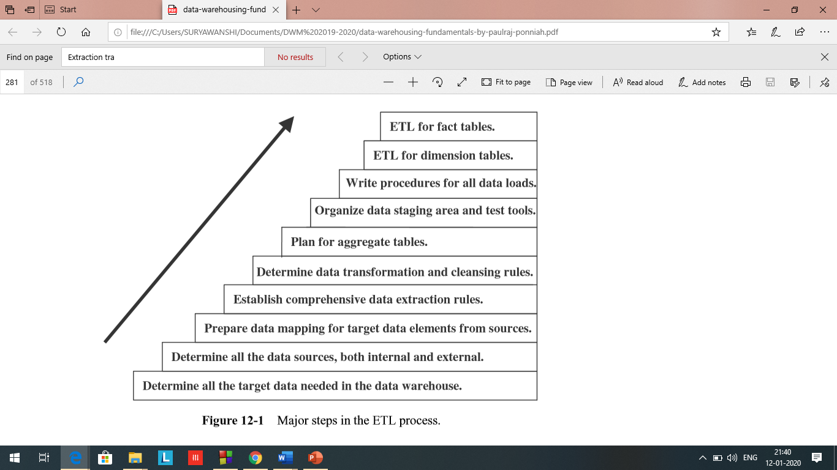
ETL Process and OLAP:
Module II
CO2: Design data warehouse with dimensional modelling and apply OLAP operations.
Major steps in ETL process
ETL functions reshape the relevant data from the source systems into useful information to be stored in the data warehouse
ETL functions is a part of the data staging area.

Slide 3
ETL Process and OLAP:
Module II
CO2: Design data warehouse with dimensional modelling and apply OLAP operations.
Major steps in ETL process
Plan for aggregate fact tables
Determine data transformation and cleansing rule
Establish comprehensive data extraction rules
Prepare data mapping and for target data elements from sources
Integrate all the data sources, both external and internal
Determine all target data needed for data warehouse
Combine several source data structures into a single row in the target database of the data warehouse.
Split one source data structure into several structures to go into several rows of the target database.
Read data from data dictionaries and catalogs of source systems.
Read data from a variety of file structures including flat files, indexed files (VSAM), and legacy system databases (hierarchical/network).
Load details for populating atomic fact tables.
Aggregate for populating aggregate or summary fact tables.
Transform data from one format in the source platform to another format in the target platform.
Derive target values for input fields (example: age from date of birth).
Change cryptic values to values meaningful to the users (example: 1 and 2 to male and female).

Slide 4
ETL Process and OLAP:
Module II
CO2: Design data warehouse with dimensional modelling and apply OLAP operations.
Data Extraction: extracting data from disparate sources, also on the changes for ongoing incremental load as well as one-initial full load
Data extraction issues:
Source Identification—identify source applications and source structures.
Method of extraction—for each data source, define whether the extraction process is manual or tool-based.
Extraction frequency—for each data source, establish how frequently the data extraction must by done—daily, weekly, quarterly, and so on.
Time window—for each data source, denote the time window for the extraction process.
Job sequencing—determine whether the beginning of one job in an extraction job stream has to wait until the previous job has finished successfully.
Exception handling—determine how to handle input records that cannot be extracted.

Slide 5
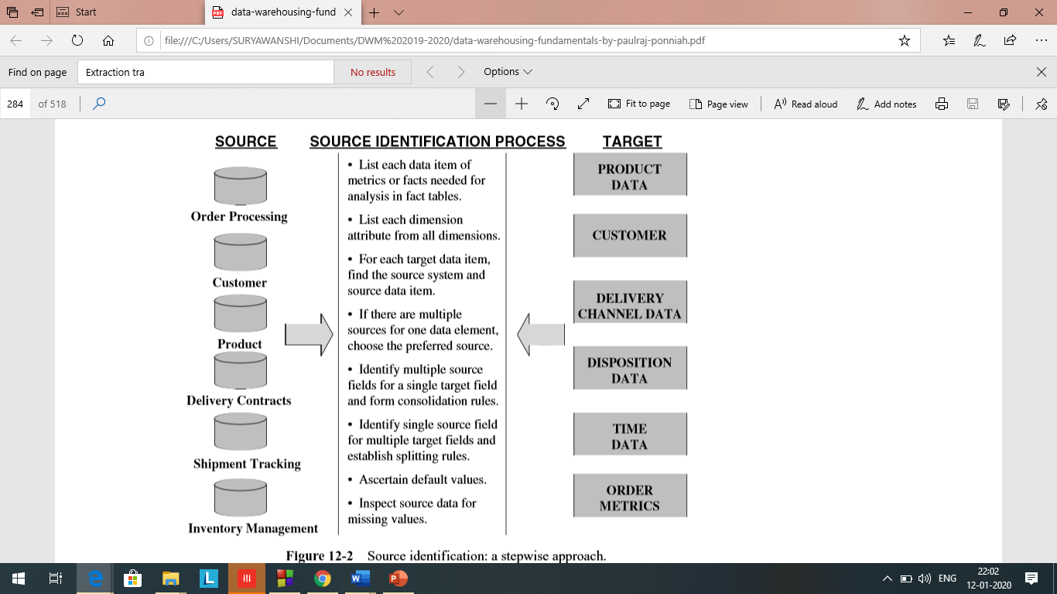
ETL Process and OLAP:
Module II
CO2: Design data warehouse with dimensional modelling and apply OLAP operations.
Data Extraction Techniques

Slide 6
ETL Process and OLAP:
Module II
CO2: Design data warehouse with dimensional modelling and apply OLAP operations.
Data Extraction Techniques

Slide 7
ETL Process and OLAP:
Module II
CO2: Design data warehouse with dimensional modelling and apply OLAP operations.
Data Extraction Techniques:
Data in the source systems are said to be time-dependent or temporal. This is because source data changes with time. The value of a single variable varies over time.
How do you capture the history from the source systems?
The answer depends on how exactly data is stored in the source systems
Data in operational systems:
Current value:
Most of the attributes in the source systems fall into this category
The values are transient or transitory. (for short time or not permanent)
Customer name and address, bank account balances, and outstanding amounts on individual orders are some examples of this category.
Periodic Status:
This category is not as common as the previous category. In this category, the value of the attribute is preserved as the status every time a change occurs. At each of these points in time, the status value is stored with reference to the time when the new value became effective.

Slide 8
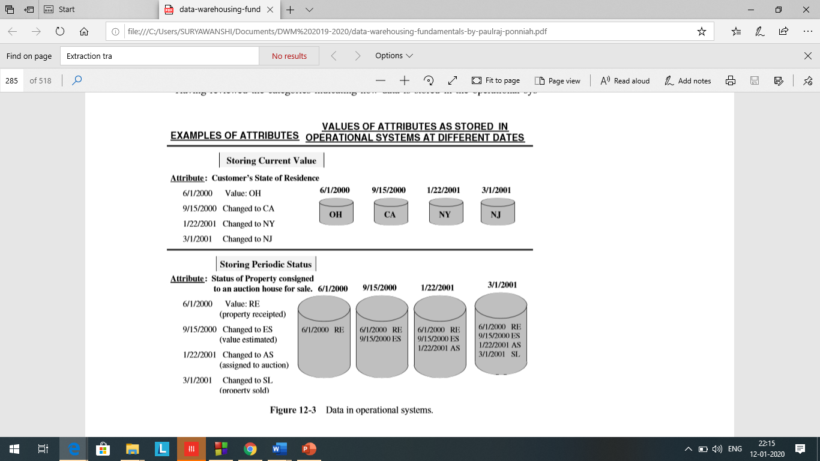
ETL Process and OLAP:
Module II
CO2: Design data warehouse with dimensional modelling and apply OLAP operations.
Data Extraction Techniques:

Slide 9
ETL Process and OLAP:
Module II
CO2: Design data warehouse with dimensional modelling and apply OLAP operations.
Data Extraction Techniques:
When you deploy your data warehouse, the initial data as of a certain time must be moved to the data warehouse to get it started. This is the initial load.
After the initial load, your data warehouse must be kept updated so the history of the changes and statuses are reflected in the data warehouse.
Broadly, there are two major types of data extractions from the source operational systems: “as is” (static) data and data of revisions.

Slide 10
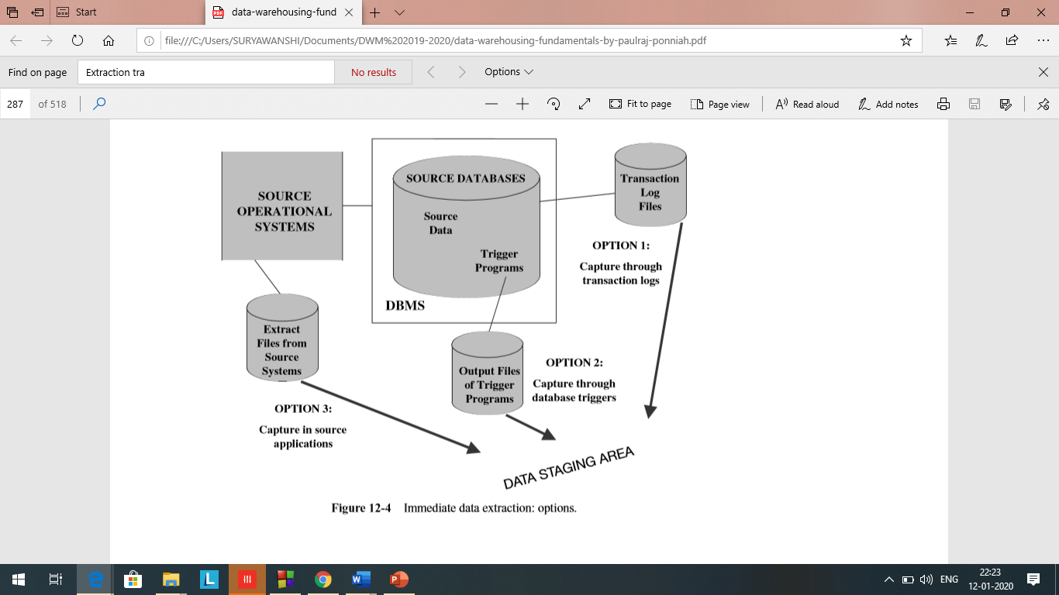
ETL Process and OLAP:
Module II
CO2: Design data warehouse with dimensional modelling and apply OLAP operations.
Data Extraction Techniques:
Immediate Data Extraction.: Data Capture is immediate or real-time

Slide 11
ETL Process and OLAP:
Module II
CO2: Design data warehouse with dimensional modelling and apply OLAP operations.
Data Extraction Techniques:
Immediate Data Extraction.
Capture through Transaction Logs: This option uses the transaction logs of the DBMSs maintained for recovery from possible failures. As each transaction adds, updates, or deletes a row from a database table, the DBMS immediately writes entries on the log file. This data extraction technique reads the transaction log and selects all the committed transactions. There is no extra overhead in the operational systems because logging is already part of the transaction processing.
You have to make sure that all transactions are extracted before the log file gets refreshed. As log files on disk storage get filled up, the contents are backed up on other media and the disk log files are reused. Ensure that all log transactions are extracted for data warehouse updates.
If some of your source system data is on indexed and other flat files (non database), this option will not work for these cases.

Slide 12
ETL Process and OLAP:
Module II
CO2: Design data warehouse with dimensional modelling and apply OLAP operations.
Data Extraction Techniques:
Immediate Data Extraction.
Capture through Database Triggers: This is applicable to your source systems that are database applications. Triggers are special stored procedures (programs) that are stored on the database and fired when certain predefined events occur. You can create trigger programs for all events for which you need data to be captured. The output of the trigger programs is written to a separate file that will be used to extract data for the data warehouse.
Data capture through database triggers occurs right at the source and is therefore quite reliable. You can capture both before and after images. However, building and maintaining trigger programs puts an additional burden on the development effort. Also, execution of trigger procedures during transaction processing of the source systems puts additional overhead on the source systems. Further, this option is applicable only for source data in databases.

Slide 13
ETL Process and OLAP:
Module II
CO2: Design data warehouse with dimensional modelling and apply OLAP operations.
Data Extraction Techniques:
Immediate Data Extraction.
Capture in Source Applications: This technique is also referred to as application-assisted data capture. Source application is made to assist in the data capture for the data warehouse. You have to modify the relevant application programs that write to the source files and databases. You revise the programs to write all adds, updates, and deletes to the source files and database tables. Then other extract programs can use the separate file containing the changes to the source data
This technique may be used for all types of source data irrespective of whether it is in databases, indexed files, or other flat files. But you have to revise the programs in the source operational systems and keep them maintained. This could be a formidable task if the number of source system programs is large. Also, this technique may degrade the performance of the source applications because of the additional processing needed to capture the changes on separate files.

Slide 14
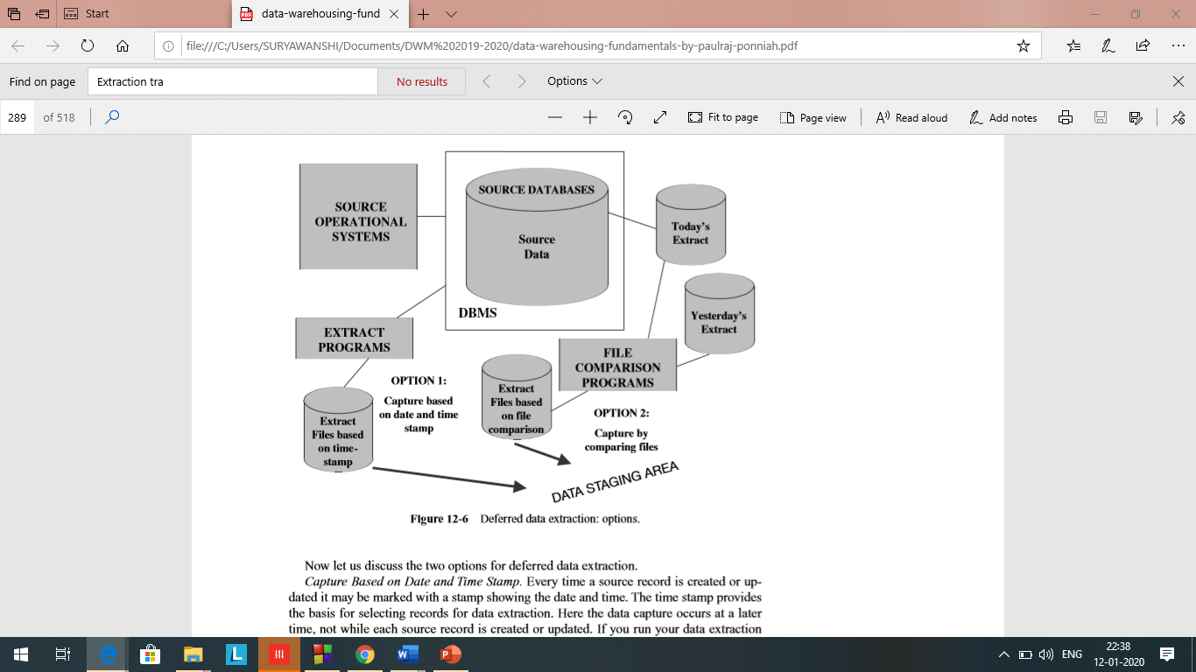
ETL Process and OLAP:
Module II
CO2: Design data warehouse with dimensional modelling and apply OLAP operations.
Data Extraction Technique:
Deferred Data Extraction:

Slide 15
ETL Process and OLAP:
Module II
CO2: Design data warehouse with dimensional modelling and apply OLAP operations.
Data Extraction Technique:
Deferred Data Extraction:
Capture Based on Date and Time Stamp: Every time a source record is created or updated it may be marked with a stamp showing the date and time. The time stamp provides the basis for selecting records for data extraction. Here the data capture occurs at a later time, not while each source record is created or updated. If you run your data extraction program at midnight every day, each day you will extract only those with the date and time stamp later than midnight of the previous day.
This technique works well if the number of revised records is small.
Deletion of source records presents a special problem. If a source record gets deleted in between two extract runs, the information about the delete is not detected. You can get around this by marking the source record for delete first, do the extraction run, and then go ahead and physically delete the record. This means you have to add more logic to the source applications.

Slide 16
ETL Process and OLAP:
Module II
CO2: Design data warehouse with dimensional modelling and apply OLAP operations.
Data Extraction Technique:
Deferred Data Extraction:
Capture by Comparing Files: If none of the above techniques are feasible for specific source files in your environment, then consider this technique as the last resort. This technique is also called the snapshot differential technique because it compares two snapshots of the source data. Let us see how this technique works.
While performing today’s data extraction for changes to product data, you do a full file comparison between today’s copy of the product data and yesterday’s copy. You also compare the record keys to find the inserts and deletes. Then you capture any changes between the two copies. This technique necessitates the keeping of prior copies of all the relevant source data. Though simple and straightforward, comparison of full rows in a large file can be very inefficient. However, this may be the only feasible option for some legacy data sources that do not have transaction logs or time stamps on source records.

Slide 17
ETL Process and OLAP:
Module II
CO2: Design data warehouse with dimensional modelling and apply OLAP operations.
Data Transformation:
Now the extracted data is raw data and it cannot be applied to the data warehouse. First, all the extracted data must be made usable in the data warehouse.
To enrich and improve the quality of the data before it could be usable in the data warehouse.
Data Transformation: Basic Tasks
Selection. This takes place at the beginning of the whole process of data transformation. You select either whole records or parts of several records from the source systems. It is prudent to extract the whole record and then do the selection as part of the transformation function.
Splitting/joining. This task includes the types of data manipulation you need to perform on the selected parts of source records. Sometimes (uncommonly), you will be splitting the selected parts even further during data transformation. Joining of parts selected from many source systems is more widespread in the data warehouse environment.

Slide 18
ETL Process and OLAP:
Module II
CO2: Design data warehouse with dimensional modelling and apply OLAP operations.
Data Transformation: Basic Tasks
3. Conversion: This is an all-inclusive task. It includes a large variety of rudimentary conversions of single fields for two primary reasons—one to standardize among the data extractions from disparate source systems, and the other to make the fields usable and understandable to the users.
4. Summarization: Sometimes you may find that it is not feasible to keep data at the lowest level of detail in your data warehouse. It may be that none of your users ever need data at the lowest granularity for analysis or querying.
For example, for a grocery chain, sales data at the lowest level of detail for every transaction at the checkout may not be needed. Storing sales by product by store by day in the data warehouse may be quite adequate. So, in this case, the data transformation function includes summarization of daily sales by product and by store.
5. Enrichment: This task is the rearrangement and simplification of individual fields to make them more useful for the data warehouse environment. You may use one or more fields from the same input record to create a better view of the data for the data warehouse. This principle is extended when one or more fields originate from multiple records, resulting in a single field for the data warehouse.

Slide 19
ETL Process and OLAP:
Module II
CO2: Design data warehouse with dimensional modelling and apply OLAP operations.
Data Transformation: Major Transformation Types
1) Format Revisions.
Changes to the data types and lengths of individual fields.
In your source systems, product package types may be indicated by codes and names in which the fields are numeric and text data types.
Again, the lengths of the package types may vary among the different source systems.
It is wise to standardize and change the data type to text to provide values meaningful to the users.

Slide 20
ETL Process and OLAP:
Module II
CO2: Design data warehouse with dimensional modelling and apply OLAP operations.
Data Transformation: Major Transformation Types
2) Decoding of Fields.
Common type of data transformation.
When you deal with multiple source systems, you are bound to have the same data items described by a plethora of field values. The classic example is the coding for gender, with one source system using 1 and 2 for male and female and another system using M and F.
Also, many legacy systems are notorious for using cryptic codes to represent business values. What do the codes AC, IN, RE, and SU mean in a customer file?
You need to decode all such cryptic codes and change these into values that make sense to the users. Change the codes to Active, Inactive, Regular, and Suspended.
.

Slide 21
ETL Process and OLAP:
Module II
CO2: Design data warehouse with dimensional modelling and apply OLAP operations.
Data Transformation: Major Transformation Types
3) Calculated and Derived Values:
What if you want to keep profit margin along with sales and cost amounts in your data warehouse tables?
The extracted data from the sales system contains sales amounts, sales units, and operating cost estimates by product.
Sometimes you have to calculate the total cost and the profit margin before data can be stored in the data warehouse, which is an example of the calculated value.
You may also want to store customer's age separately—that would be an example of the derived value.

Slide 22
ETL Process and OLAP:
Module II
CO2: Design data warehouse with dimensional modelling and apply OLAP operations.
Data Transformation: Major Transformation Types
4) Splitting of Single Fields.
Earlier legacy systems stored names and addresses of customers and employees in large text fields.
The first name, middle initials, and last name were stored as a large text in a single field.
Similarly, some earlier systems stored city, state, and Zip Code data together in a single field.
You need to store individual components of names and addresses in separate fields in your data warehouse for two reasons.
First, you may improve the operating performance by indexing on individual components.
Second, your users may need to perform analysis by using individual components such as city, state, and Zip Code.

Slide 23
ETL Process and OLAP:
Module II
CO2: Design data warehouse with dimensional modelling and apply OLAP operations.
Data Transformation: Major Transformation Types
5) Merging of Fields:
not quite the opposite of splitting of single fields.
Does not literally mean the merging of several fields to create a single field of data.
For example, information about a product may come from different data sources. The product code and description may come from one data source. The relevant package types may be found in another data source. The cost data may be from yet another source. In this case, merging of information denotes the combination of the product code, description, package types, and cost into a single entity. .

Slide 24
ETL Process and OLAP:
Module II
CO2: Design data warehouse with dimensional modelling and apply OLAP operations.
Data Transformation: Major Transformation Types
6) Character Set Conversion:
This type of data transformation relates to the conversion of character sets to an agreed standard character set for textual data in the data warehouse.
If you have mainframe legacy systems as source systems, the source data from these systems will be in EBCDIC characters.
If PC-based architecture is the choice for your data warehouse, then you must convert the mainframe EBCDIC format to the ASCII format.
When your source data is on other types of hardware and operating systems, you are faced with similar character set conversions.

Slide 25
ETL Process and OLAP:
Module II
CO2: Design data warehouse with dimensional modelling and apply OLAP operations.
Data Transformation: Major Transformation Types
7) Conversion of Units of Measurements:
Many companies today have global branches.
Measurements in many European countries are in metric units.
If your company has overseas operations, you may have to convert the metrics so that the numbers may all be in one standard unit of measurement.

Slide 26
ETL Process and OLAP:
Module II
CO2: Design data warehouse with dimensional modelling and apply OLAP operations.
Data Transformation: Major Transformation Types
8) Date/Time Conversion:
This type relates to representation of date and time in standard formats.
For example, the American and the British date formats may be standardized to an international format.
The date of October 11, 2000 is written as 10/11/2000 in the U.S. format and as 11/10/2000 in the British format. This date may be standardized to be written as 11 OCT 2000.

Slide 27
ETL Process and OLAP:
Module II
CO2: Design data warehouse with dimensional modelling and apply OLAP operations.
Data Transformation: Major Transformation Types
9) Summarization:
This type of transformation is the creating of summaries to be loaded in the data warehouse instead of loading the most granular level of data.
For example, for a credit card company to analyze sales patterns, it may not be necessary to store in the data warehouse every single transaction on each credit card.
Instead, you may want to summarize the daily transactions for each credit card and store the summary data instead of storing the most granular data by individual transactions.

Slide 28
ETL Process and OLAP:
Module II
CO2: Design data warehouse with dimensional modelling and apply OLAP operations.
Data Transformation: Major Transformation Types
10) Key Restructuring.
While extracting data from your input sources, look at the primary keys of the extracted records.
You will have to come up with keys for the fact and dimension tables based on the keys in the extracted records.
Eg. The product code in the organization is structured to have inherent meaning. If you use this product code as the primary key, there would be problems.
If the product is moved to another warehouse, the warehouse part of the product key will have to be changed.
This is a typical problem with legacy systems. When choosing keys for your data warehouse database tables, avoid such keys with built-in meanings.
Transform such keys into generic keys generated by the system itself. This is called key restructuring.

Slide 29
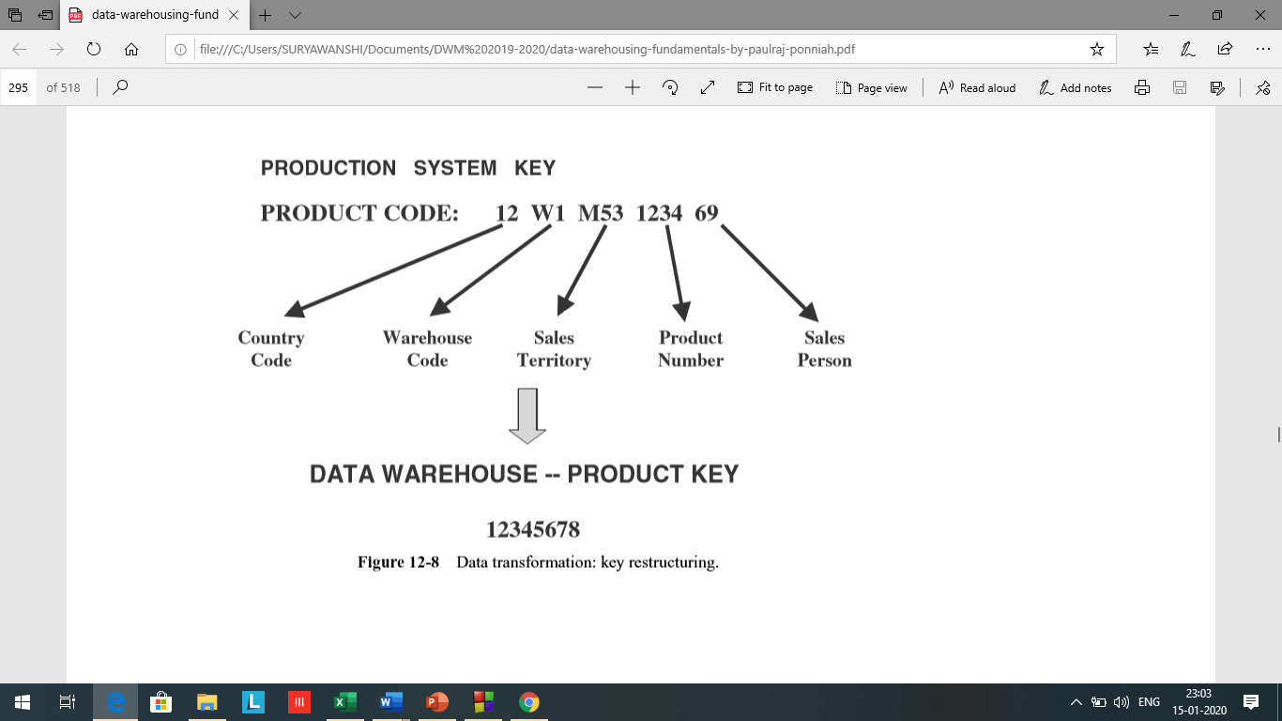
ETL Process and OLAP:
Module II
CO2: Design data warehouse with dimensional modelling and apply OLAP operations.
Data Transformation: Major Transformation Types
10) Key Restructuring.

Slide 30
ETL Process and OLAP:
Module II
CO2: Design data warehouse with dimensional modelling and apply OLAP operations.
Data Transformation: Major Transformation Types
11) Deduplication:
In many companies, the customer files have several records for the same customer.
Mostly, the duplicates are the result of creating additional records by mistake.
In your data warehouse, you want to keep a single record for one customer and link all the duplicates in the source systems to this single record.
This process is called deduplication of the customer file. Employee files and, sometimes, product master files have this kind of duplication problem.

Slide 31
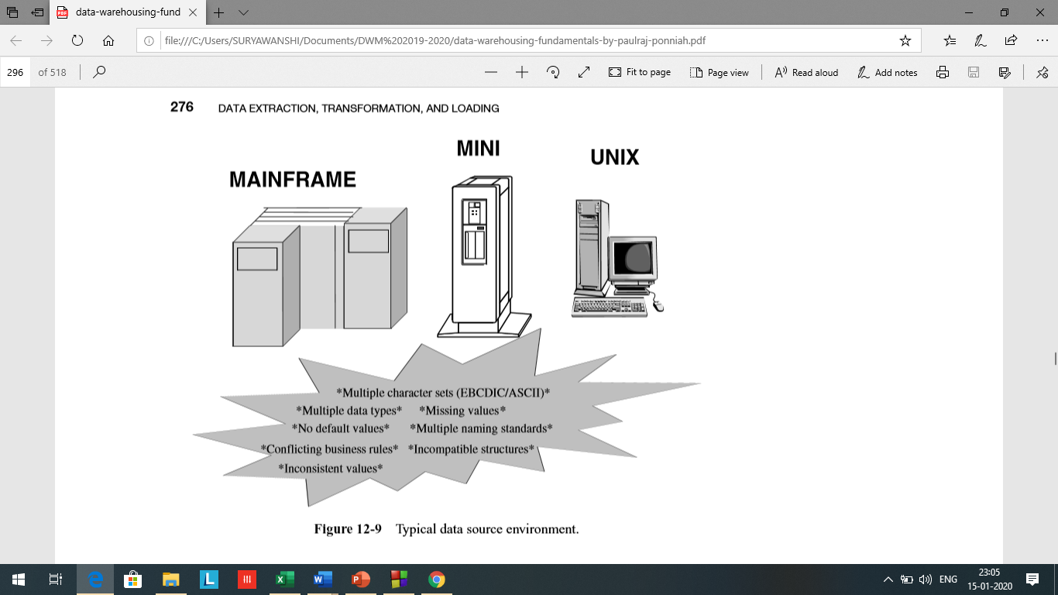
ETL Process and OLAP:
Module II
CO2: Design data warehouse with dimensional modelling and apply OLAP operations.
Data Transformation:

Slide 32
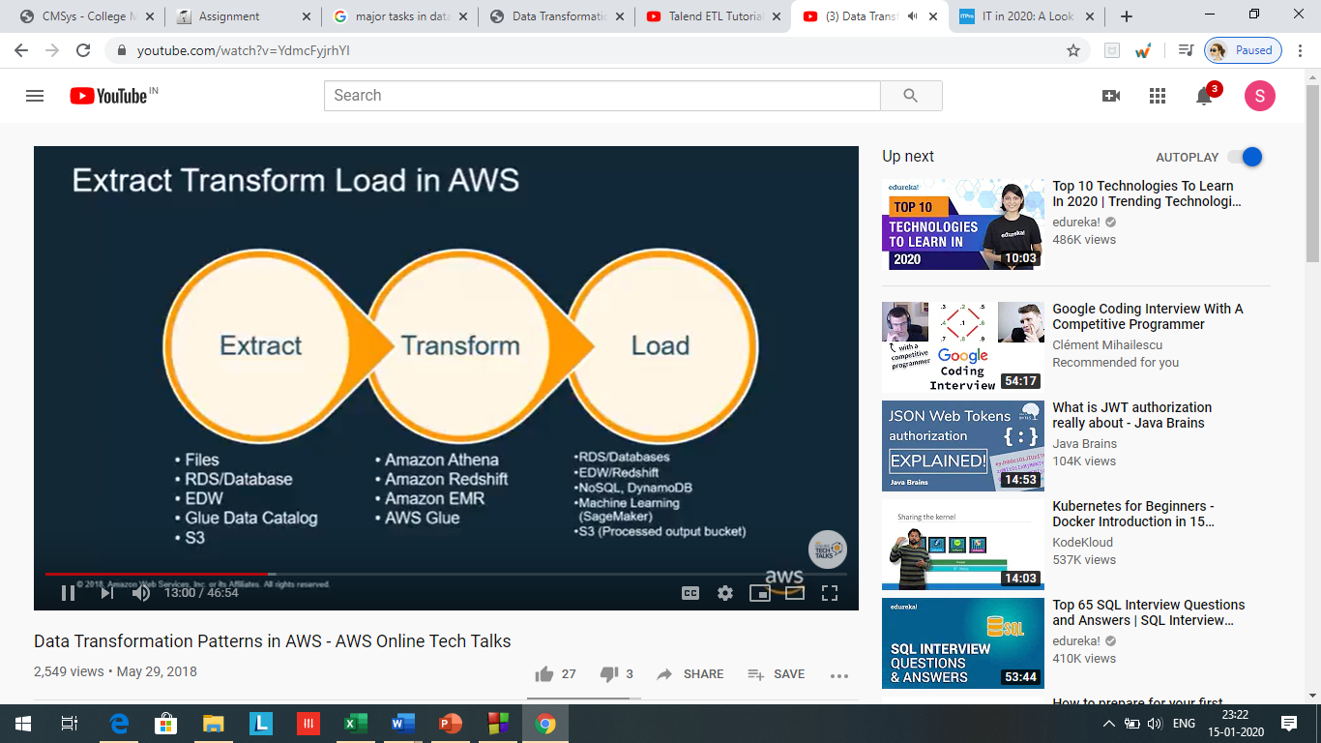
ETL Process and OLAP:
Module II
CO2: Design data warehouse with dimensional modelling and apply OLAP operations.
Data Transformation:

Slide 33
ETL Process and OLAP:
Module II
CO2: Design data warehouse with dimensional modelling and apply OLAP operations.
Data Loading:
Initial Load—populating all the data warehouse tables for the very first time
Incremental Load—applying ongoing changes as necessary in a periodic manner
Full Refresh—completely erasing the contents of one or more tables and reloading with fresh data (initial load is a refresh of all the tables)

Slide 34
ETL Process and OLAP:
Module II
CO2: Design data warehouse with dimensional modelling and apply OLAP operations.
Data Loading:
During the loads, the data warehouse has to be offline.
Find a window of time when the loads may be scheduled without affecting your data warehouse users.
Thus dividing up the whole load process into smaller chunks and populating a few files at a time. So we can run the smaller loads in parallel. Also, you might be able to keep some parts of the data warehouse up and running while loading the other parts.
It is hard to of the loads, especially the initial load or a completeestimate the running times refresh.
Do test loads to verify the correctness and to estimate the running times.

Slide 35
ETL Process and OLAP:
Module II
CO2: Design data warehouse with dimensional modelling and apply OLAP operations.
Data Loading : Let us take the example of product data.
For the initial load, you extract the data for all the products from the various source systems, integrate and transform the data, and then create load images for loading the data into the product dimension table.
For an incremental load, you collect the changes to the product data for those product records that have changed in the source systems since the previous extract, run the changes through the integration and transformation process, and create output records to be applied to the product dimension table.
A full refresh is similar to the initial load.
In every case, you create a file of data to be applied to the product dimension table in the data warehouse. How can you apply the data to the warehouse? What are the modes? Data may be applied in the following four different modes: load, append, destructive merge, and constructive merge.

Slide 36
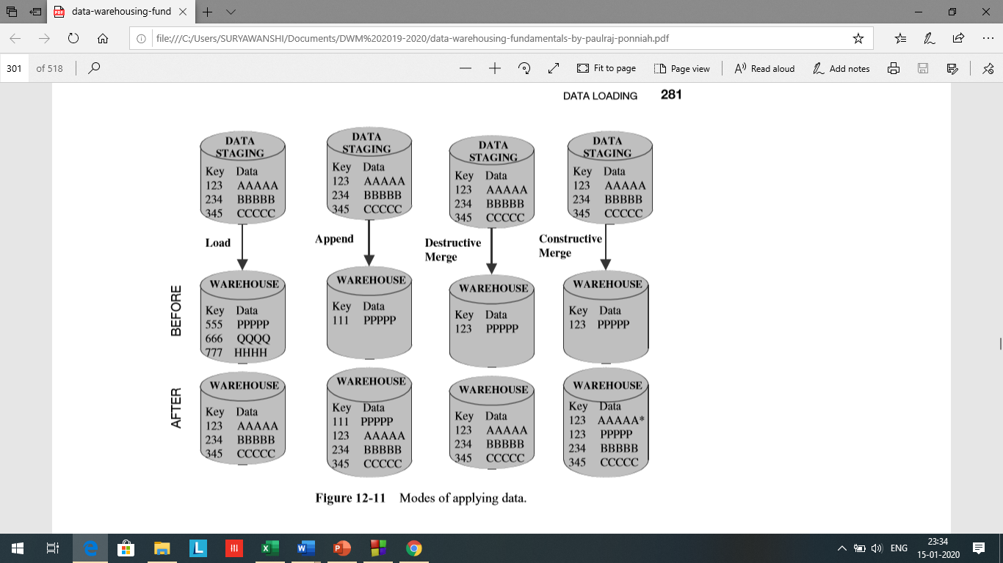
ETL Process and OLAP:
Module II
CO2: Design data warehouse with dimensional modelling and apply OLAP operations.
Data Loading: Various modes to apply the data to warehouse
Load:
If the target table to be loaded already exists and data exists in the table, the load process wipes out the existing data and applies the data from the incoming file. If the table is already empty before loading, the load process simply applies the data from the incoming file

Slide 37
ETL Process and OLAP:
Module II
CO2: Design data warehouse with dimensional modelling and apply OLAP operations.
Data Loading: Various modes to apply the data to warehouse
Append:
You may think of the append as an extension of the load. If data already exists in the table, the append process unconditionally adds the incoming data, preserving the existing data in the target table. When an incoming record is a duplicate of an already existing record, you may define how to handle an incoming duplicate. The incoming record may be allowed to be added as a duplicate. In the other option, the incoming duplicate record may be rejected during the append process.

Slide 38
ETL Process and OLAP:
Module II
CO2: Design data warehouse with dimensional modelling and apply OLAP operations.
Data Loading: Various modes to apply the data to warehouse
Destructive Merge :
In this mode, you apply the incoming data to the target data. If the primary key of an incoming record matches with the key of an existing record, update the matching target record. If the incoming record is a new record without a match with any existing record, add the incoming record to the target table.

Slide 39
ETL Process and OLAP:
Module II
CO2: Design data warehouse with dimensional modelling and apply OLAP operations.
Data Loading: Various modes to apply the data to warehouse
Constructive Merge.
This mode is slightly different from the destructive merge. If the primary key of an incoming record matches with the key of an existing record, leave the existing record, add the incoming record, and mark the added record as superceding the old record.

Slide 40
ETL Process and OLAP:
Module II
CO2: Design data warehouse with dimensional modelling and apply OLAP operations.
Data Loading:
Initial Load.
Let us say you are able to load the whole data warehouse in a single run. As a variation of this single run, let us say you are able to split the load into separate subloads and run each of these subloads as single loads. In other words, every load run creates the database tables from scratch. In these cases, you will be using the load mode discussed above. If you need more than one run to create a single table, and your load runs for a single table must be schedule to run several days, then the approach is different. For the first run

Slide 41
ETL Process and OLAP:
Module II
CO2: Design data warehouse with dimensional modelling and apply OLAP operations.
Data Loading: Various modes to apply the data to warehouse
load, append, destructive merge, and constructive merge.

Slide 42
ETL Process and OLAP:
Module II
CO2: Design data warehouse with dimensional modelling and apply OLAP operations.
Data Refresh Versus Update:
After the initial load, you may maintain the data warehouse and keep it up-to-date by using two methods:
Update—application of incremental changes in the data sources
Refresh—complete reload at specified intervals
Technically, refresh is a much simpler option than update. To use the update option, you have to devise the proper strategy to extract the changes from each data source.

Slide 43
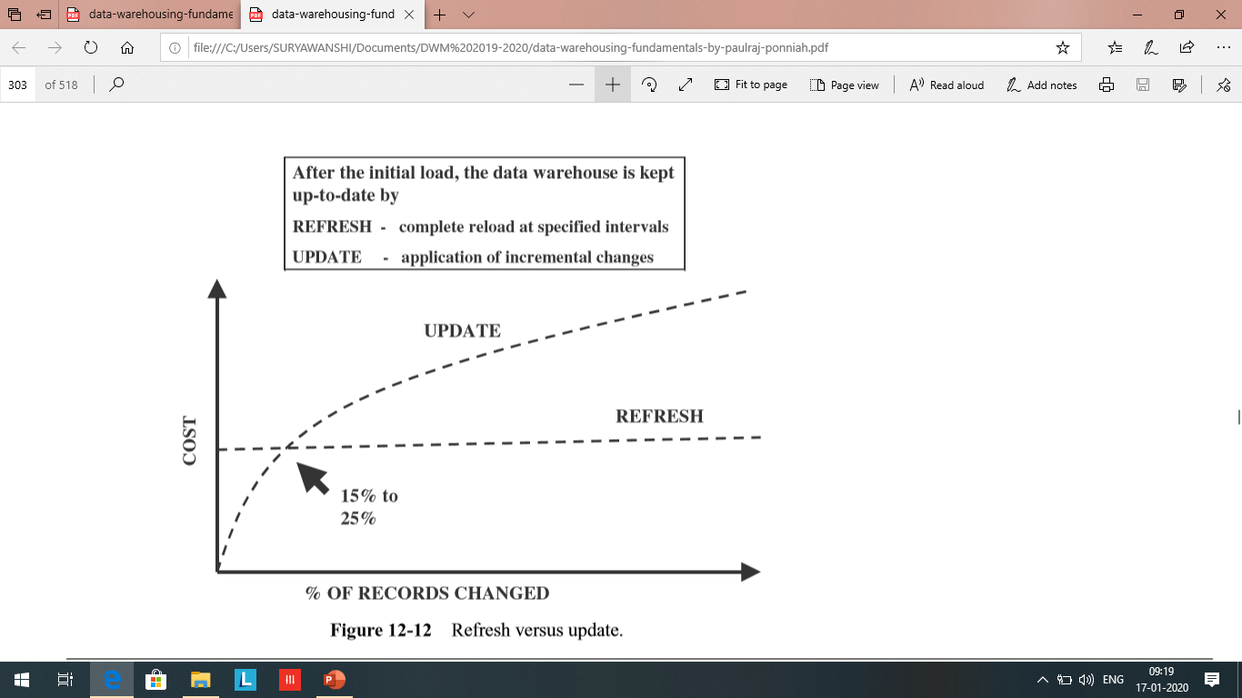
ETL Process and OLAP:
Module II
CO2: Design data warehouse with dimensional modelling and apply OLAP operations.
Data Refresh Versus Update:
Is there some kind
of a guideline as to
when refresh is
better than
update or vice versa?

Slide 44
ETL Process and OLAP:
Module II
CO2: Design data warehouse with dimensional modelling and apply OLAP operations.
Data Refresh Versus Update:
If the number of records to be updated falls between 15 and 25% of the total number of records, the cost of loading per record tends to be the same whether you opt for a full refresh of the entire data warehouse or to do the updates
If more than 25% of the source records change daily, then seriously consider full refreshes.

Slide 45
ETL Process and OLAP:
Module II
CO2: Design data warehouse with dimensional modelling and apply OLAP operations.
Procedure for Dimension tables:
In a data warehouse, dimension tables contain attributes that are used to analyze basic measurements such as sales and costs.
As you know very well, customer, product, time, and sales territory are examples of dimension tables.
The procedure for maintaining the dimension tables includes two functions: first, the initial loading of the tables; thereafter, applying the changes on an ongoing basis.

Slide 46
ETL Process and OLAP:
Module II
CO2: Design data warehouse with dimensional modelling and apply OLAP operations.
Procedure for Dimension tables:
The first one is about the keys of the records in the source systems and the keys of the records in the data warehouse.
We do not use the production system keys for the records in the data warehouse. In the data warehouse, you use system generated keys. The records in the source systems have their own keys. Therefore, before source data can be applied to the dimension tables, whether for the initial load or for ongoing changes, the production keys must be converted to the system-generated keys in the data warehouse.

Slide 47
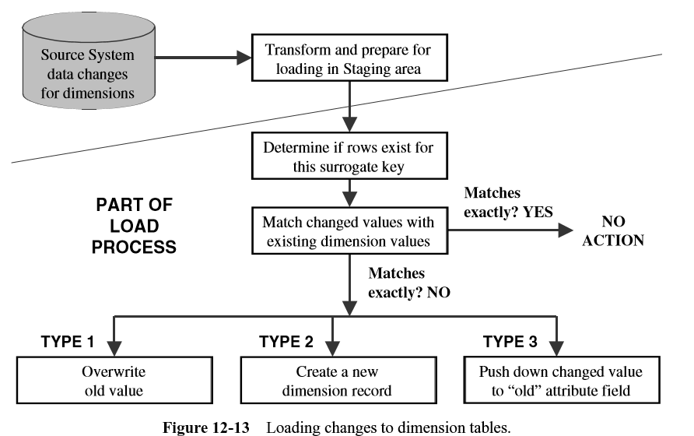
ETL Process and OLAP:
Module II
CO2: Design data warehouse with dimensional modelling and apply OLAP operations.
Procedure for Dimension tables:
The next issue relates to the application of the Type 1, Type 2, and Type 3 dimension changes to the data warehouse

Slide 48
ETL Process and OLAP:
Module II
CO2: Design data warehouse with dimensional modelling and apply OLAP operations.
Fact Tables: History and Incremental Loads :
The key of the fact table is the concatenation of the keys of the dimension tables. Therefore, for this reason, dimension records are loaded first.
Then, before loading each fact table record, you have to create the concatenated key for the fact table record from the keys of the corresponding dimension records.

Slide 49
ETL Process and OLAP:
Module II
CO2: Design data warehouse with dimensional modelling and apply OLAP operations.
Fact Tables: History and Incremental Loads :
Here are some tips for history loads of the fact tables:
Identify historical data useful and interesting for the data warehouse
Define and refine extract business rules
Capture audit statistics to tie back to operational systems
Perform fact table surrogate key look-up
Improve fact table content
Restructure the data
Prepare the load files

Slide 50
ETL Process and OLAP:
Module II
CO2: Design data warehouse with dimensional modelling and apply OLAP operations.
Fact Tables: History and Incremental Loads :
Given below are a few useful remarks about incremental loads for fact tables:
Incremental extracts for fact tables
Consist of new transactions
Consist of update transactions
Use database transaction logs for data capture
Incremental loads for fact tables
Load as frequently as feasible
Use partitioned files and indexes
Apply parallel processing techniques

Slide 51
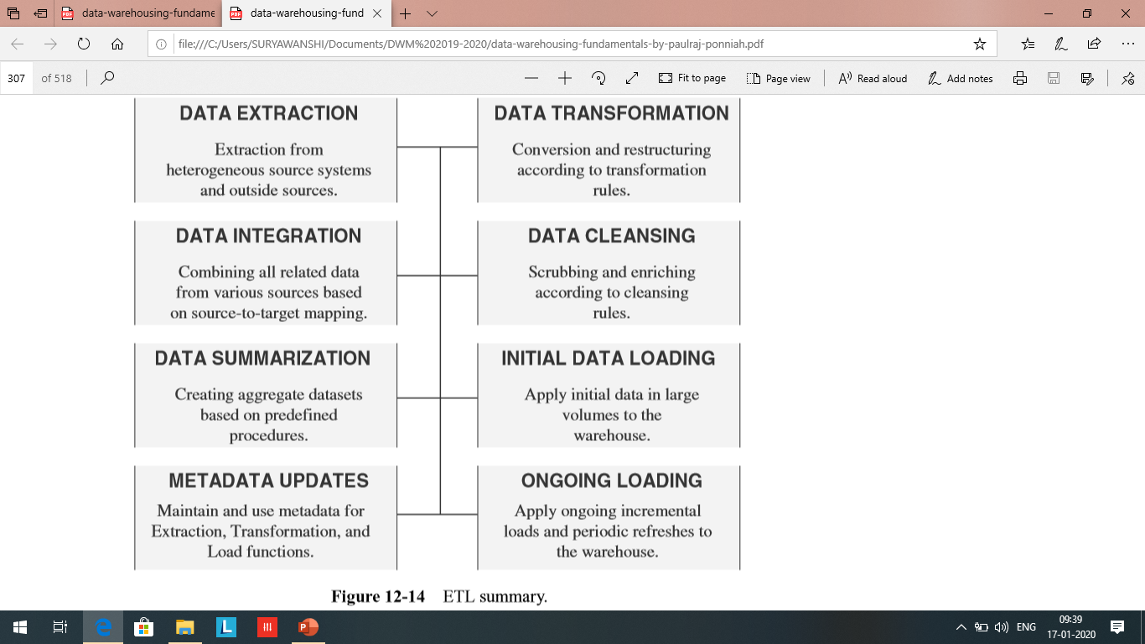
ETL Process and OLAP:
Module II
CO2: Design data warehouse with dimensional modelling and apply OLAP operations.
ETL Summary

Slide 52
ETL Process and OLAP:
Module II
CO2: Design data warehouse with dimensional modelling and apply OLAP operations.
OLAP:
OLTP Vs OLAP,
OLAP definition,
Dimensional Analysis,
Hypercubes,
OLAP operations: Drill down, Roll up, Slice, Dice and Rotation,
OLAP models : MOLAP, ROLAP.

Slide 53
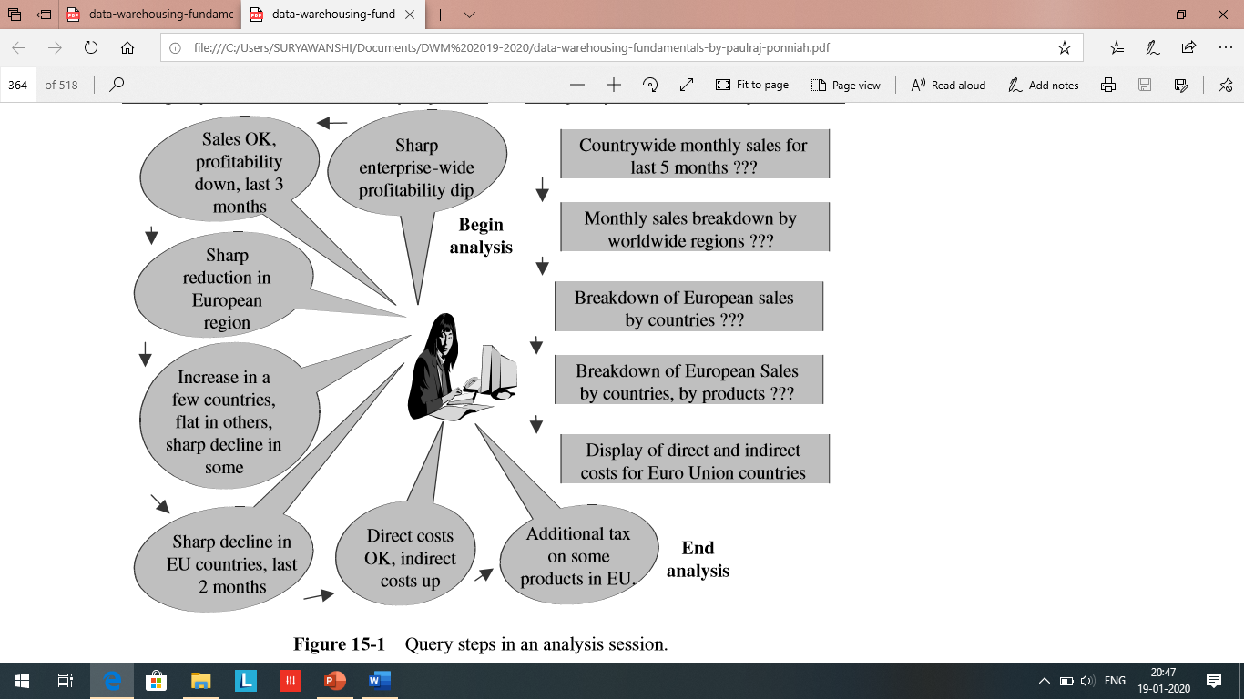
ETL Process and OLAP:
Module II
CO2: Design data warehouse with dimensional modelling and apply OLAP operations.
OLAP:

Slide 54
ETL Process and OLAP:
Module II
CO2: Design data warehouse with dimensional modelling and apply OLAP operations.
OLAP:
Roll-ups to provide summaries and aggregations along the hierarchies of the dimensions.
Drill-downs from the top level to the lowest along the hierarchies of the dimensions, in combinations among the dimensions.
Simple calculations, such as computation of margins (sales minus costs).
Share calculations to compute the percentage of parts to the whole.
Algebraic equations involving key performance indicators.
Moving averages and growth percentages.
Trend analysis using statistical methods.

Slide 55
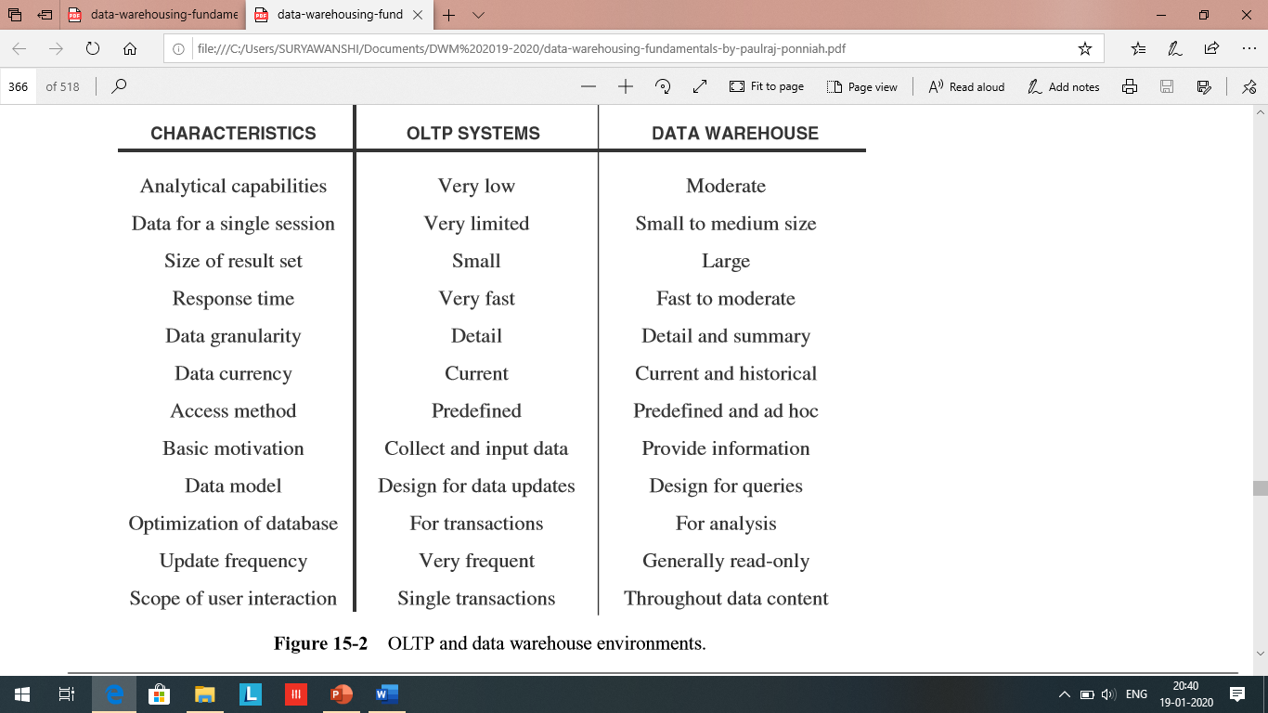
ETL Process and OLAP:
Module II
CO2: Design data warehouse with dimensional modelling and apply OLAP operations.
OLTP Vs OLAP:

Slide 56
ETL Process and OLAP:
Module II
CO2: Design data warehouse with dimensional modelling and apply OLAP operations.
OLAP definition:
Enables analysts, executives, and managers to gain useful insights from the presentation of data.
Can reorganize metrics along several dimensions and allow data to be viewed from different perspectives, Supports multidimensional analysis.
Is able to drill down or roll up within each dimension.
Is capable of applying mathematical formulas and calculations to measures.
Provides fast response, facilitating speed-of-thought analysis.
Complements the use of other information delivery techniques such as data mining.
Improves the comprehension of result sets through visual presentations using graphs and charts.
Can be implemented on the Web.
Designed for highly interactive analysis.

Slide 57
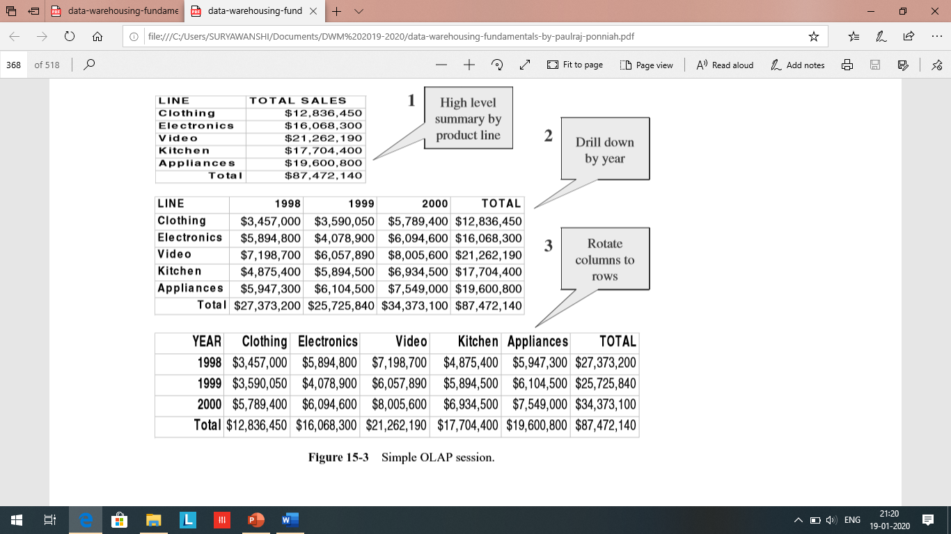
ETL Process and OLAP:
Module II
CO2: Design data warehouse with dimensional modelling and apply OLAP operations.

Slide 58
ETL Process and OLAP:
Module II
CO2: Design data warehouse with dimensional modelling and apply OLAP operations.
OLAP definition:
The term OLAP or online analytical processing was introduced in a paper entitled “Providing On-Line Analytical Processing to User Analysts,” by Dr. E. F. Codd, the acknowledged “father” of the relational database model. The paper, published in 1993, defined 12 rules or guidelines for an OLAP system. Later, in 1995, six additional rules were included.
On-Line Analytical Processing (OLAP) is a category of software technology that enables analysts, managers and executives to gain insight into data through fast, consistent, interactive access in a wide variety of possible views of information that has been transformed from raw data to reflect the real dimensionality of the enterprise as understood by the user.

Slide 59
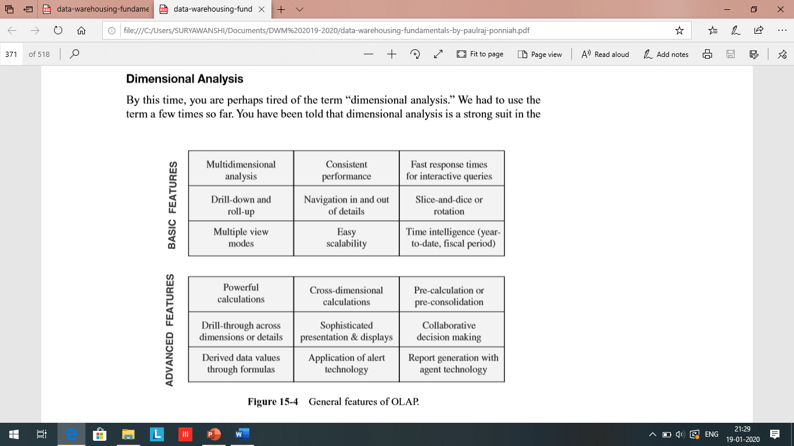
ETL Process and OLAP:
Module II
CO2: Design data warehouse with dimensional modelling and apply OLAP operations.

Slide 60
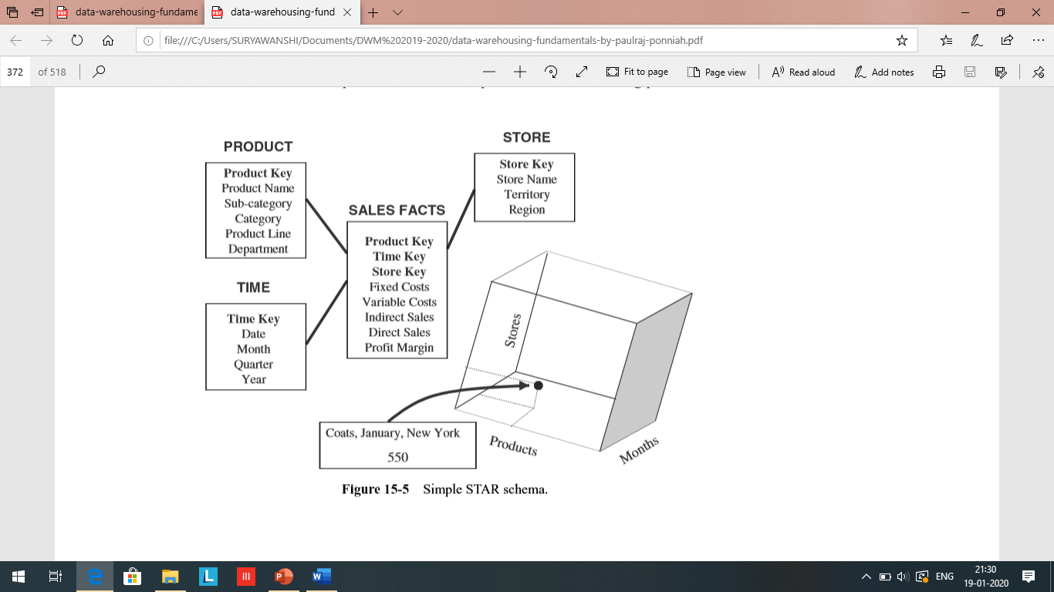
ETL Process and OLAP:
Module II
CO2: Design data warehouse with dimensional modelling and apply OLAP operations.
Dimensional Analysis

Slide 61
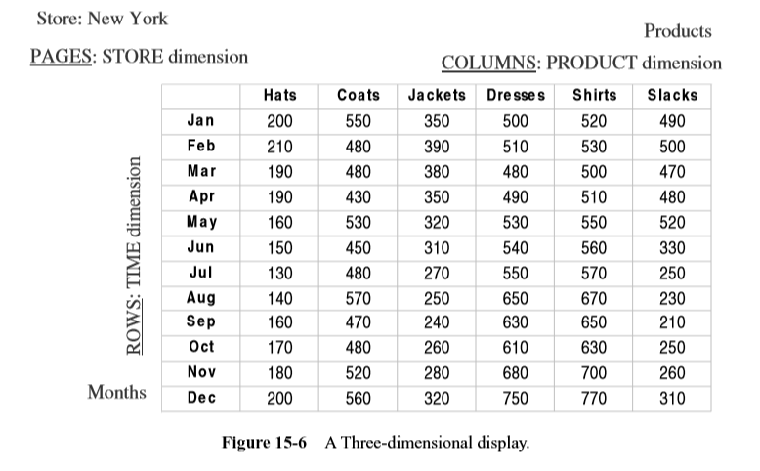
ETL Process and OLAP:
Module II
CO2: Design data warehouse with dimensional modelling and apply OLAP operations.
Dimensional Analysis

Slide 62
ETL Process and OLAP:
Module II
CO2: Design data warehouse with dimensional modelling and apply OLAP operations.
1) Query :
Display the total sales of all products for past five years in all stores.
Display of Results :
Rows: Year numbers 2000, 1999, 1998, 1997, 1996
Columns: Total Sales for all products
Page: All stores
2) Query
Compare total sales for all stores, product by product, between years 2000 and 1999.
Display of Results
Rows: Year numbers 2000, 1999; difference; percentage increase or decrease
Columns: One column per product, showing all products
Page: All stores

Slide 63
ETL Process and OLAP:
Module II
CO2: Design data warehouse with dimensional modelling and apply OLAP operations.
3) Query : Show comparison of total sales for all stores, product by product, between years 2000 and 1999 only for those products with reduced sales.
Display of Results
Rows: Year numbers 2000, 1999; difference; percentage decrease
Columns: One column per product, showing only the qualifying products
Page: All stores
4) Query : Show comparison of sales by individual stores, product by product, between years 2000 and 1999 only for those products with reduced sales.
Display of Results
Rows: Year numbers 2000, 1999; difference; percentage decrease
Columns: One column per product, showing only the qualifying products
Page: One store per page

Slide 64
ETL Process and OLAP:
Module II
CO2: Design data warehouse with dimensional modelling and apply OLAP operations.
5) Query : Show the results of the previous query, but rotating and switching the columns with rows.
Display of Results
Rows: One row per product, showing only the qualifying products
Columns: Year numbers 2000, 1999; difference; percentage decrease
Page: One store per page
**This multidimensional analysis can continue on until the analyst determines how many products showed reduced sales and which stores suffered the most.

Slide 65
ETL Process and OLAP:
Module II
CO2: Design data warehouse with dimensional modelling and apply OLAP operations.
What are Hypercubes?
How do you represent a four-dimensional model with data points along the edges of a three-dimensional cube?
How do you slice the data to display pages?
Let us begin with the two business dimensions of product and time.
Usually, business users wish to analyze not just sales but other metrics as well. Assume that the metrics to be analyzed are fixed cost, variable cost, indirect sales, direct sales, and profit margin. These are five common metrics.

Slide 66
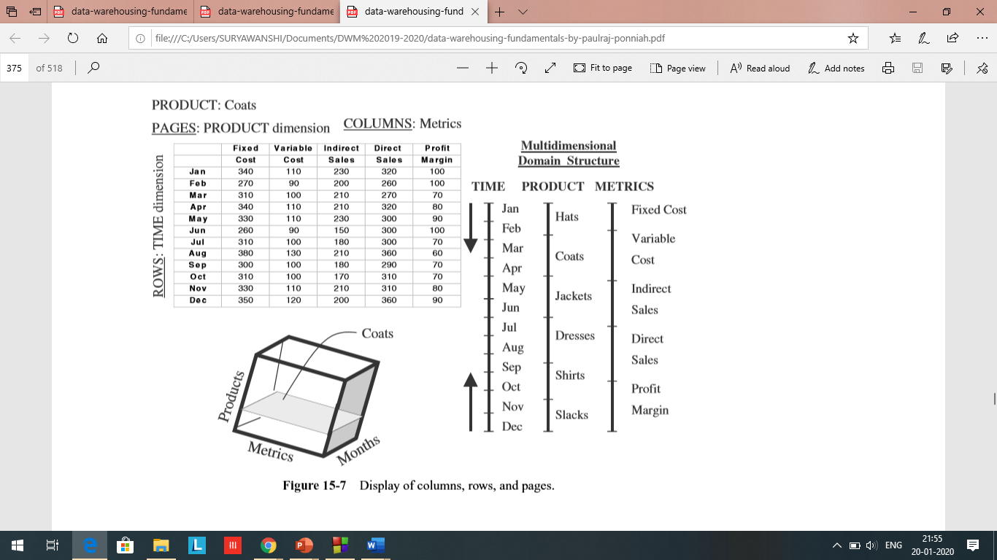
ETL Process and OLAP:
Module II
CO2: Design data warehouse with dimensional modelling and apply OLAP operations.
What are Hypercubes?
Sample page of the
spreadsheet display.

Slide 67
ETL Process and OLAP:
Module II
CO2: Design data warehouse with dimensional modelling and apply OLAP operations.
What are Hypercubes?
In the figure, please also note the three straight lines,
two of which represent the two business dimensions
and the third, the metrics.
You can independently move up or down along
the straight lines.
Some experts refer to this representation of
a multidimension as a
multidimensional domain structure (MDS).

Slide 68
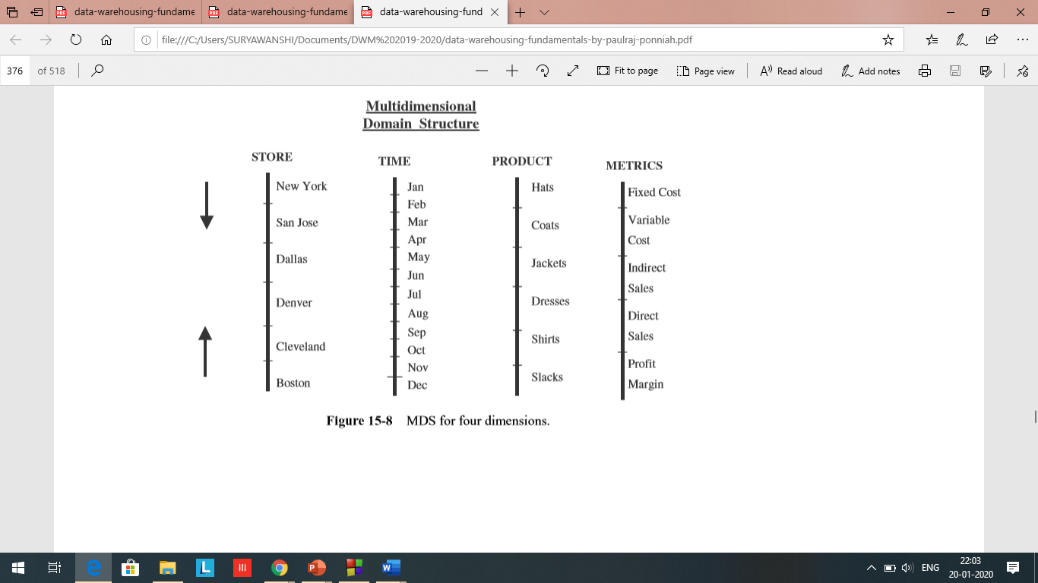
ETL Process and OLAP:
Module II
CO2: Design data warehouse with dimensional modelling and apply OLAP operations.
What are Hypercubes?
Now add another business dimension
to the model.
Let us add the store dimension.
That results in three business
dimensions
plus the metrics data.

Slide 69
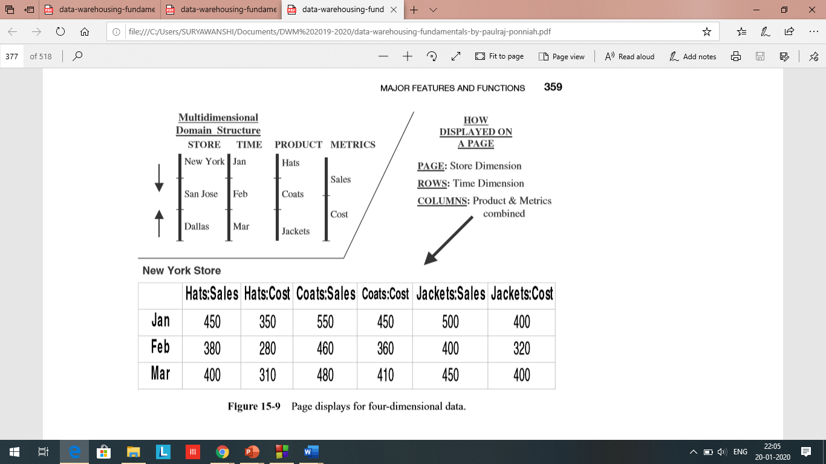
ETL Process and OLAP:
Module II
CO2: Design data warehouse with dimensional modelling and apply OLAP operations.
.

Slide 70
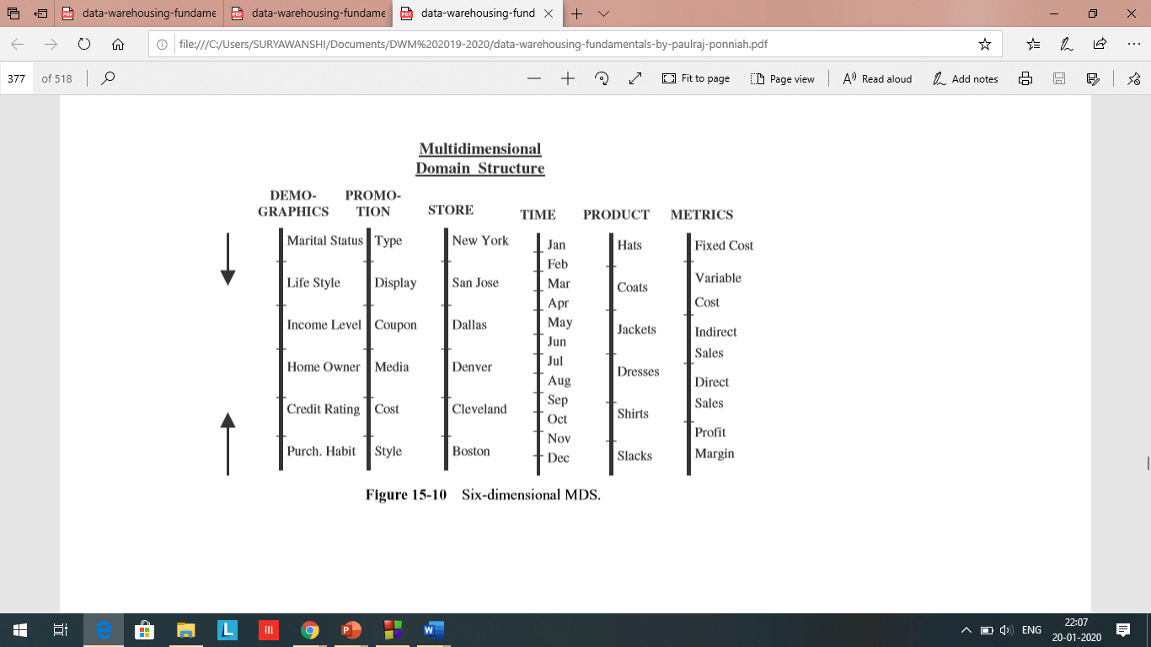
ETL Process and OLAP:
Module II
CO2: Design data warehouse with dimensional modelling and apply OLAP operations.
What are Hypercubes?
Let us move up to six dimensions.
Please study Figure 15-10 with
six straight lines showing the
data representations.
The dimensions shown
in this figure are
product, time, store, promotion,
customer demographics,
and metrics.

Slide 71
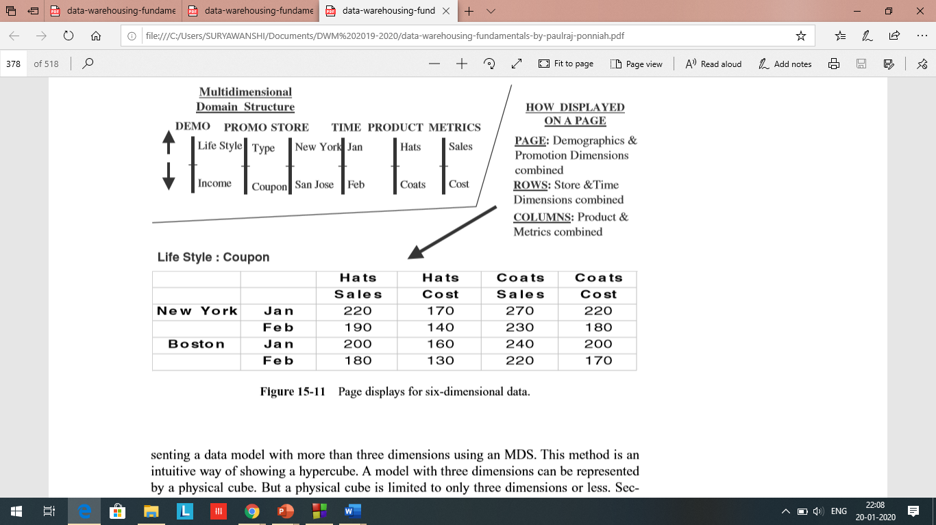
ETL Process and OLAP:
Module II
CO2: Design data warehouse with dimensional modelling and apply OLAP operations.
This method is an intuitive way of showing a hypercube

Slide 72
ETL Process and OLAP:
Module II
CO2: Design data warehouse with dimensional modelling and apply OLAP operations.
Operation using OLAP
Drill-Down
Roll-Up
Slice
Dice
Pivot/Rotate

Slide 73
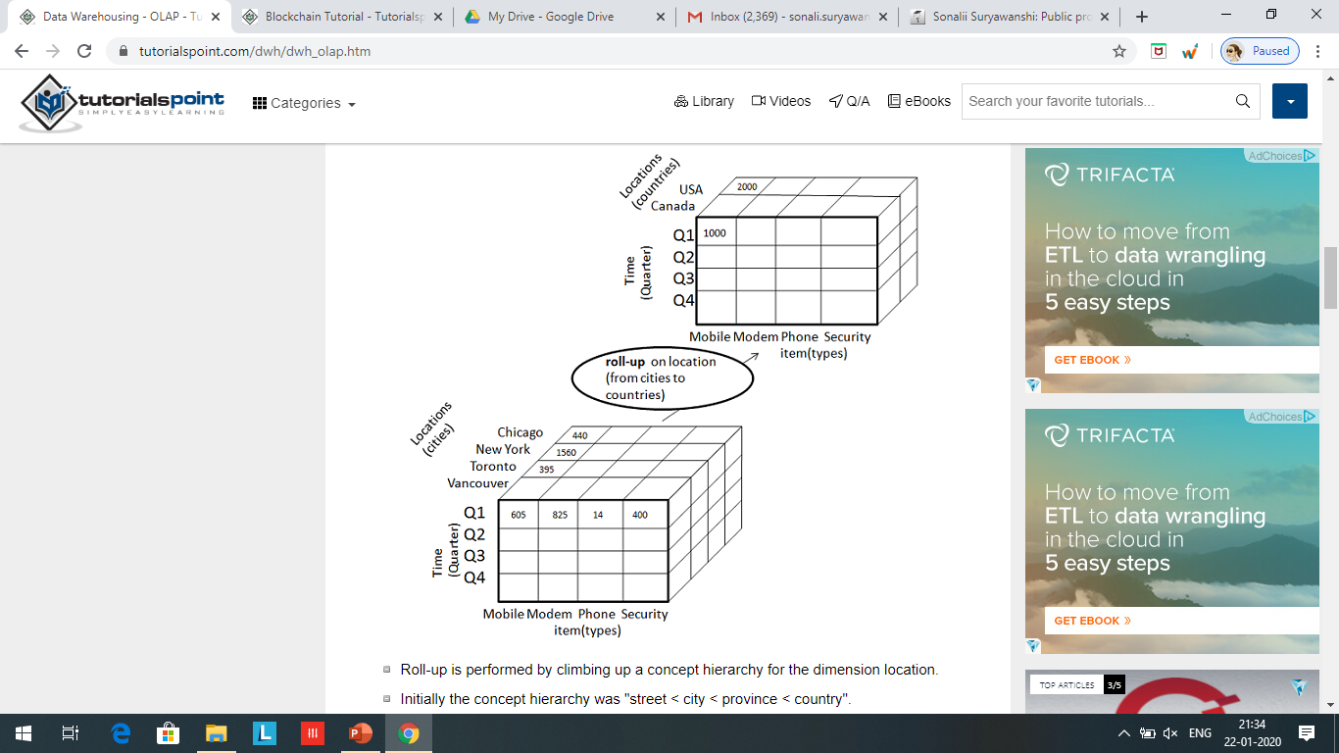
ETL Process and OLAP:
Module II
CO2: Design data warehouse with dimensional modelling and apply OLAP operations.
Operation using OLAP: Roll-Up

Slide 74
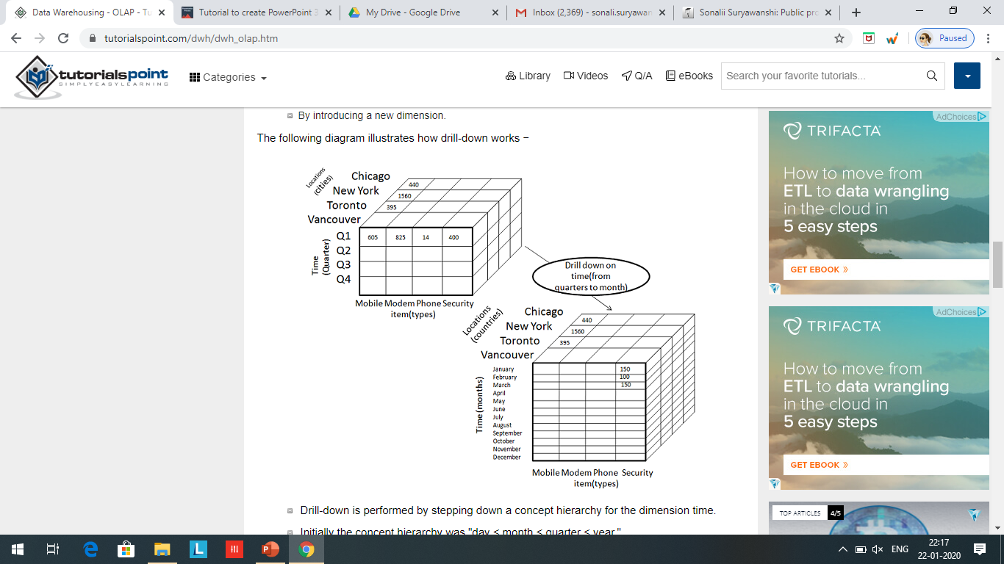
ETL Process and OLAP:
Module II
CO2: Design data warehouse with dimensional modelling and apply OLAP operations.
Operation using OLAP: Drill Down

Slide 75
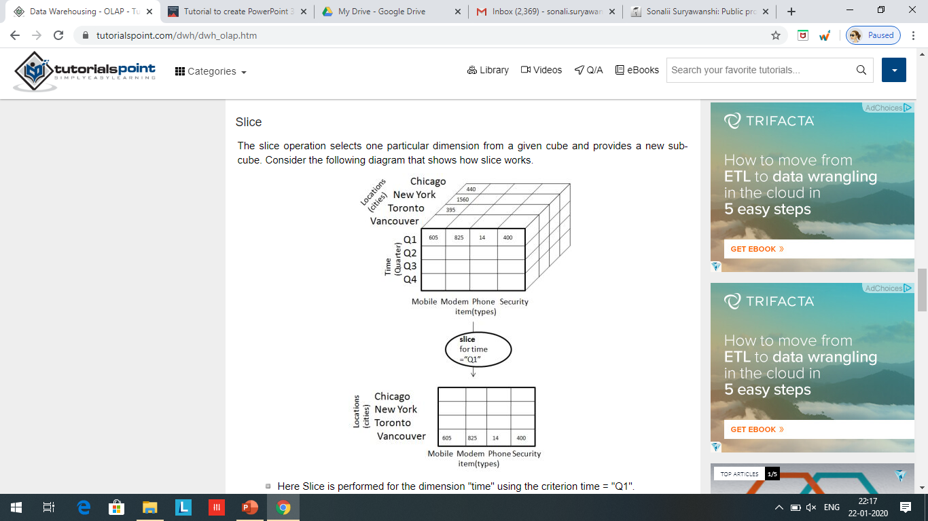
ETL Process and OLAP:
Module II
CO2: Design data warehouse with dimensional modelling and apply OLAP operations.
Operation using OLAP: Slice

Slide 76
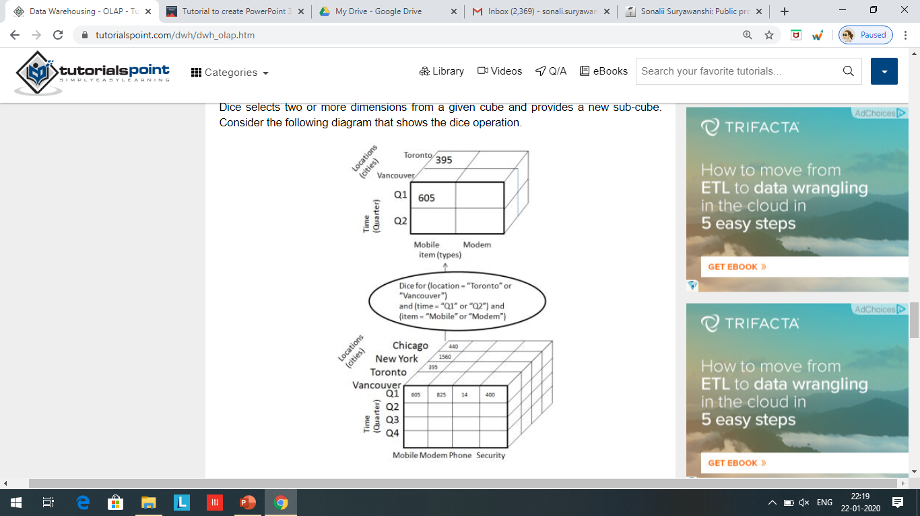
ETL Process and OLAP:
Module II
CO2: Design data warehouse with dimensional modelling and apply OLAP operations.
Operation using OLAP: dice
Dice selects two or more dimensions from a given cube and provides a new sub-cube. Consider the following diagram that shows the dice operation.

Slide 77
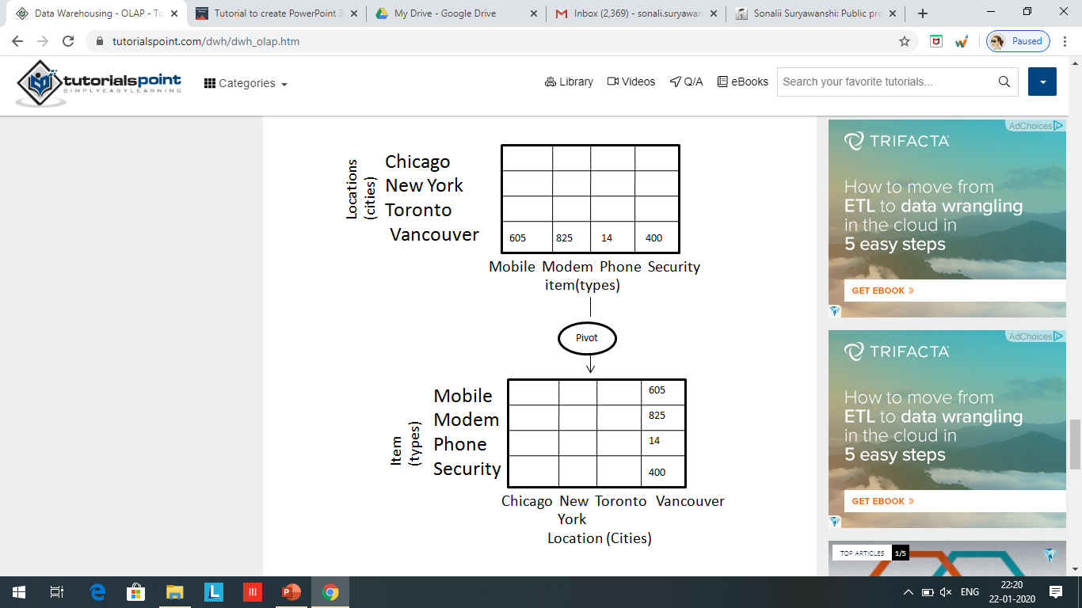
ETL Process and OLAP:
Module II
CO2: Design data warehouse with dimensional modelling and apply OLAP operations.
Operation using OLAP: Pivot

Slide 78
ETL Process and OLAP:
Module II
CO2: Design data warehouse with dimensional modelling and apply OLAP operations.
Operation using OLAP: Roll-Up
Delhi
310
120
Haryana
220
310
120
220
310
120
Pune
220
Maharashtra
490
460
320
150
340
170
490
460
320
120
Mumbai
120
150
300
320
340
120
150
340
120
150
170
150
300
100
Q1
150
900
300
420
110
Q1
110
400
420
700
100
420
250
Q2
650
400
420
200
250
320
120
Q2
420
200
200
150
220
120
150
Q3
370
Q3
120
Coats
Hats
Jackets
Coats
Hats
Jackets

Slide 79
ETL Process and OLAP:
Module II
CO2: Design data warehouse with dimensional modelling and apply OLAP operations.
OLAP MODELS:
ROLAP: Relational Online Analytical Processing
MOLAP: Multidimensional Online Analytical Processing

Slide 80
ETL Process and OLAP:
Module II
CO2: Design data warehouse with dimensional modelling and apply OLAP operations.
OLAP MODELS:
ROLAP: Relational Online Analytical Processing
MOLAP: Multidimensional Online Analytical Processing

Slide 81
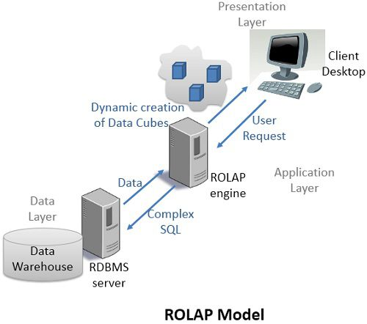
ETL Process and OLAP:
Module II
CO2: Design data warehouse with dimensional modelling and apply OLAP operations.
OLAP MODELS: ROLAP
stored as rows and columns in relational form
data to the users in the form of business dimensions

Slide 82
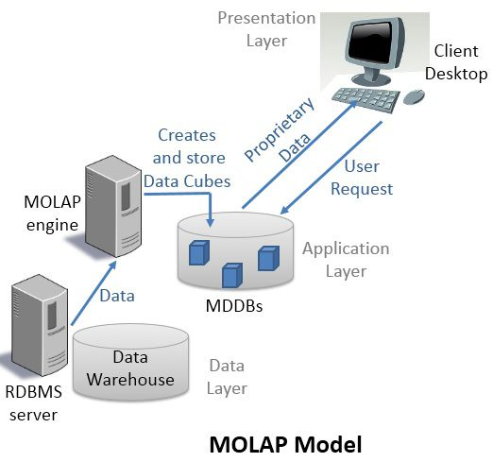
ETL Process and OLAP:
Module II
CO2: Design data warehouse with dimensional modelling and apply OLAP operations.
OLAP MODELS: MOLAP

Slide 83
ETL Process and OLAP:
Module II
CO2: Design data warehouse with dimensional modelling and apply OLAP operations.
Suppose that a data warehouse consists of the three dimensions time, doctor and patient and two measures count and charge, where charge is the fee that doctor charges a patient for a visit
Draw a star schema diagram for the above data warehouse
Strating with base cuboid [day, doctor, patient] what specific OLAP operations should be performed in order to list the total fee collected by each doctor in 2010
To obtain the same list, write an SQL query assuming the data are stored in a relational database with schema fee(day, month, year, doctor, hospital, patient, count, charges)

